Slide 1
Immunization: More than just Needles
Karen Beckermann
Associate Director, Vaccine Preventable Diseases
14. April 2018

Slide 2
Vaccines are the closest thing we have to a miracle
Dr. Sue Desmond-Hellmann, CEO,
Bill & Melinda Gates Foundation
Notes:
Who’s in the room
Where in the province
Your nursing classification, anything else,
Your role in immunization (immunizer, counselor, advisor, fridge monitor)

Slide 3
Objectives
By the end of the session you will be familiar with:
The different components of the publicly funded immunization schedule for Ontario
AEFIs and how to report
Pain management strategies
Components of vaccine hesitancy
Resources for more information

Slide 4
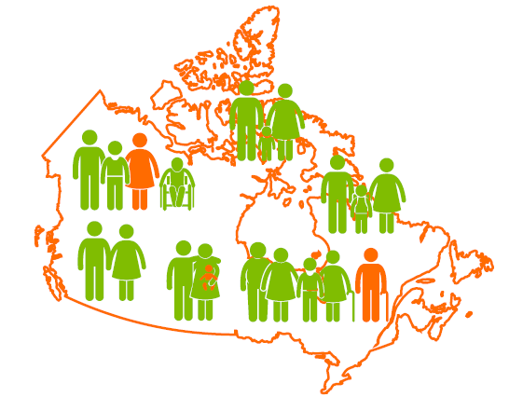
Strengthening Protection
When majority of the people are immunized, it prevents the spread of contagious diseases.
Community immunity protects newborns and people with weakened immune systems who cannot get the vaccines.

Slide 5
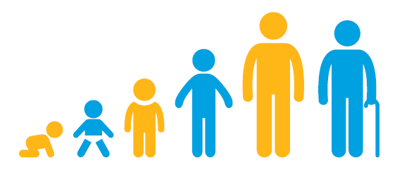
Not just for kids
adults boosters
recommend vaccines based on lifestyle, age and risk factors
vaccines for travel or occupation

Slide 6
Publicly Funded Routine Vaccine Schedule
Notes:
Anything but routine
Various catch-up schedules depending on if 1-6 years of age, 7-17 years, or 18+
All vaccines are important for your child’s health. The vaccines list in bolded font are required for attending school

Slide 7
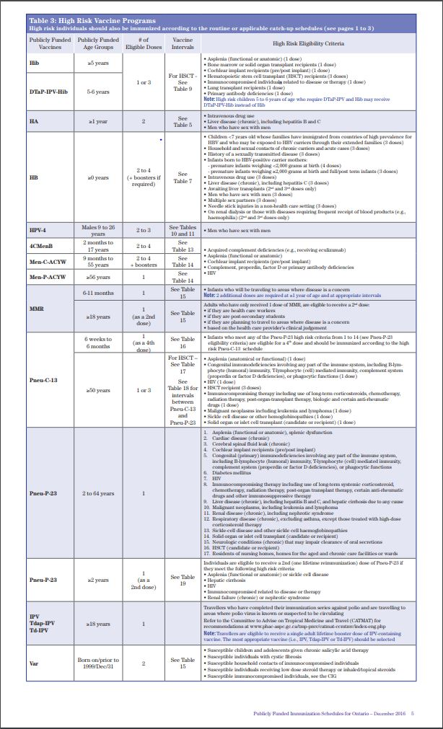
Publicly Funded High Risk Vaccine Schedule
Ministry Version
TPH version
Notes:
- Not easy but so important;

Slide 8


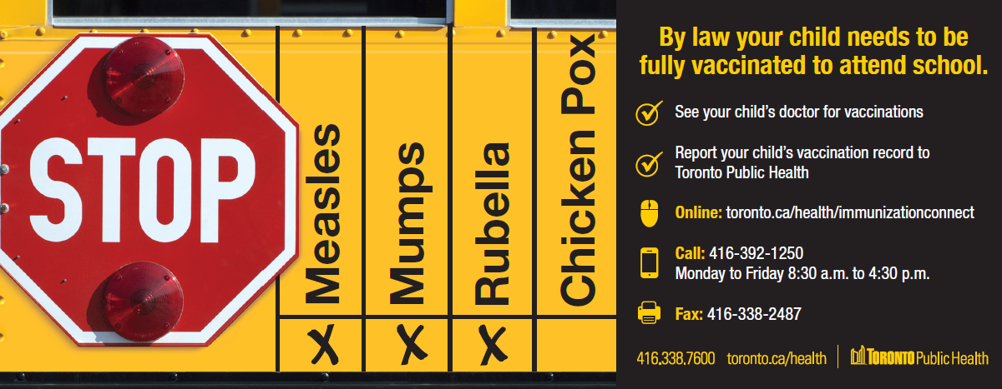

Immunization of School Pupils Act
Notes:
The Act was updated in 2011 to align with publicly funded vaccination schedule
More updates in 2017… mandatory education, mandatory provider reporting coming soon

Slide 9

Immunization of School Pupils Act
To keep all children healthy, parents are required, by law to report their child’s vaccination against the following nine diseases:
measles
mumps
rubella
diphtheria
tetanus
polio
pertussis
meningococcal
and chickenpox for children born on or after 2010
Notes:
The Act has been updated in 2014 to align with publicly funded vaccination schedule – sort of; the dates are niggly…
CAN Immunize has a free app to keep family’s immunization record all in one place. It will send parents reminders of when their next vaccine is due; or if there is an outbreak in their area.

Slide 10
Adverse Events Following Immunization
An unwanted or unexpected health effect that happens after someone receives a vaccine, which may or may not be caused by the vaccine.
When you report you provide vital information to monitor vaccine safety
See Public Health Ontario AEFI Factsheet
If you unsure be proactive and report the event.

Slide 11
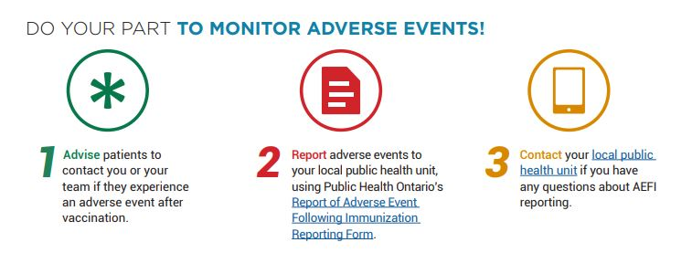
AEFIs – Do your part

Slide 12
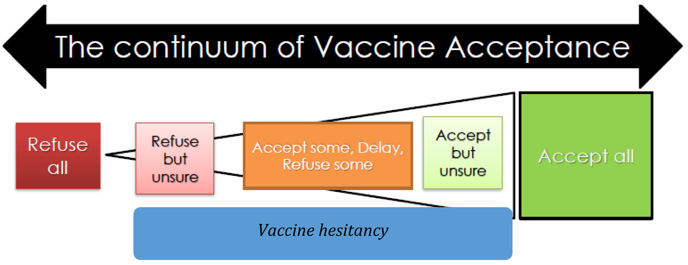
What is vaccine hesitancy?
  Vaccine hesitancy
  “delay in acceptance/refusal of vaccines despite availability of vaccination services”
d
http://nobleresearch.org/Doi/10.14312/2053-1273.2015-4

Slide 13
Why not get vaccinated?
  It’s complicated
  3 C’s:
    Confidence
      70% concerned about SE
      38% believed vaccine causes disease it is supposed to prevent
    Complacency
    Convenience

Slide 14
When counselling vaccine hesitant parents
  Start early!
    ?Prenatal
    ?Before 1st immunization visit
    ?Before they become parents
  Present vaccination as default (presumptive)
    rather than asking how they feel
  Give a strong recommendation
Notes:
People trust their provider
Listen
Be clear and simple
Share your story… why you get vaccinated
Give strategies to reduce pain… lot’s of great resources

Slide 15

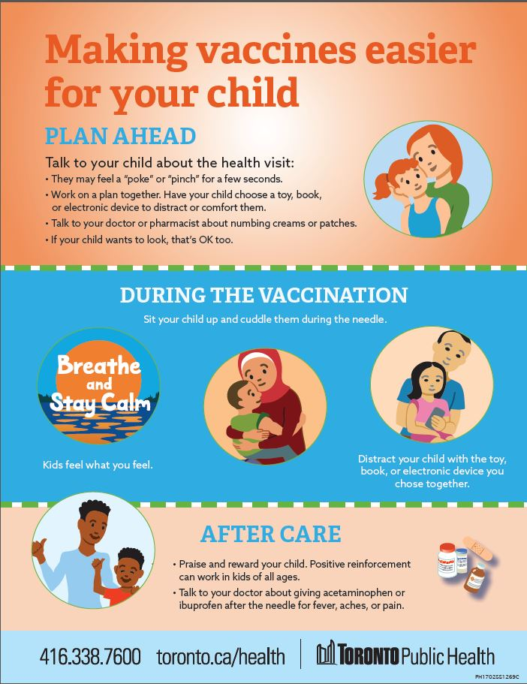
Making vaccines easier
Notes:
Check out our website
See immunize Canada

Slide 16

Other Resources
CANImmunize app: download free app to record and store immunization records, receive alerts and disease outbreaks.
A Parent's Guide to Vaccination Booklet for new parents. Available in 12 languages
Notes:
Immunization App can be downloaded on most phones or tablets. The postcard advertising the app is available in most offices. The app is also promoted on TPH’s website.
A Parent's Guide to Vaccination Booklet for new parents should be available in most offices. Additional copies can be ordered from PHAC. Available in English, French, Arabic, Chinese, Farsi/Persian, Korean, Punjabi, Russian, Spanish, Tagalog, Tamil and Urdu.

Slide 17
Helping You Help Your Patients
  Toronto Public Health: Information for Health Professionals: Immunization
  Immunize Canada
  National Advisory Committee on Immunization
Notes:
TPH has many resources to help you help your patients:
Vaccine fact sheets on our web site (lay language for patients)
Interpreting the schedule is challenging, especially when people started their series somewhere else, TPH can help with interpretation (Immunization information phone line on the next slide)
Call your local public health department

Slide 18

Be a super hero!
Take a quiz and save a life.
Go to I boost immunity.
Every answer you get right, they will donate one vaccine to the global immunization program.

Slide 19
Thank You!
Everyone who supports immunization is quietly saving lives, every minute of every day. That’s a beautiful thing.
Notes:
I heard this from Natasha Crowcroft but not sure where she got it…

Slide 20
Karen.Beckermann@toronto.ca

