Slide 1
Advance Care Planning:
The Critical Role of Primary Care in Opening the Conversation
Vicki Bassett Rn PNC (C ) BNSc Med
LiZ Brennan RN BScN
The AcademiC Family Health Team

Slide 2

Acknowledgements
Lynn Kachuik, APN Palliative Care, TOH
Karen Kennedy, Social Work, West Park FHT, Toronto
Nadine Valk, Executive Director, Champlain LHIN, Palliative Care Hospice Program
TOH FHT Task Team Members:
  Katharine Standish, SW
  Tiffiny Anders-Visser, NP
  Dr. Eoghan O’Shea- Family Physician
  Vince Gilpin, Patient representative
Melissa Radcliffe, Co-op student

Slide 3
Learning Objectives
Define advance care planning ( ACP) and related terms
Review the literature on ACP in primary care
Discuss the role of nurses in an interprofessional approach to advance care planning conversations in a Family Health Team
Identify ACP implementation and education strategies for team and patients
Discuss project challenges
Practice initiating an advance care planning conversation
Share resources for learning

Slide 4
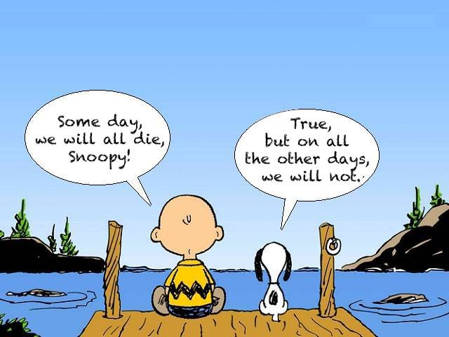

Slide 5
Advance care planning is often thought of as planning for the end of life. But advance care planning is really about planning for life, up to and including death. It is a process of thinking about what is important to you. What are your beliefs, values and wishes for your care?
Advance care planning is also about sharing those wishes so that your family and friends know how you would like to be cared for in the future if you couldn’t speak for yourself.

Slide 6
Advance
Care Planning
Which of the following statements is true?
Advance Care Planning can be done by:
An individual who is mentally capable.
A Substitute Decision for an individual who is not mentally capable.
A physician for an individual who is not mentally capable.
All of the above
Answer : A
Notes:
The words we use are very important to create shared understanding and meaning
Many of these terms are borrowed from other jurisdictions and provinces – when we use some of them in Ontario it can create confusion.
If time, ask the audience what they understand about that term to demonstrate how the term can be used/interpreted differently by different people.

Slide 7
Advance
Care Planning
True or False?
There are two ways to determine who your Substitute Decision Maker is.
True
Identifying your automatic SMD(s) on the hierarchy.
Completing a POWER OF ATTORNEY FOR PERSONAL CARE.
Notes:
The words we use are very important to create shared understanding and meaning
Many of these terms are borrowed from other jurisdictions and provinces – when we use some of them in Ontario it can create confusion.
If time, ask the audience what they understand about that term to demonstrate how the term can be used/interpreted differently by different people.

Slide 8
Advance
Care Planning
True or False?
You can have more than one Substitute Decision Maker (appointed in a POA or on the hierarchy).
True
But…Remember multiple SDMs need to AGREE on how to move forward together.
Notes:
The words we use are very important to create shared understanding and meaning
Many of these terms are borrowed from other jurisdictions and provinces – when we use some of them in Ontario it can create confusion.
If time, ask the audience what they understand about that term to demonstrate how the term can be used/interpreted differently by different people.

Slide 9
You can share your wishes verbally or in written form.
True
In Ontario, you can communicate your wishes, values and beliefs any way you want (it does not need to be written down).
Your last known wishes apply over any previously expressed wishes.
Advance
Care Planning
Notes:
The words we use are very important to create shared understanding and meaning
Many of these terms are borrowed from other jurisdictions and provinces – when we use some of them in Ontario it can create confusion.
If time, ask the audience what they understand about that term to demonstrate how the term can be used/interpreted differently by different people.

Slide 10
What’s in a Name?
Advance Directives
Living Will
POA
Goals of Care
Levels of Care
Personal Directive
Advance Care Plan
Advance Care Planning….
Notes:
The words we use are very important to create shared understanding and meaning
Many of these terms are borrowed from other jurisdictions and provinces – when we use some of them in Ontario it can create confusion.
If time, ask the audience what they understand about that term to demonstrate how the term can be used/interpreted differently by different people.

Slide 11
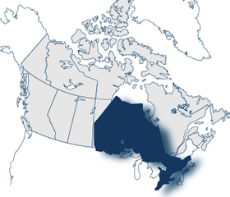
In Ontario
Three terms you need to know:
Health Care Consent (HCC)
Substitute Decision Maker (SDM)
Advance Care Planning (ACP)

Slide 12
Health Care Consent
To give informed consent, the individual must be mentally capable of making decisions about their treatment:
  understand information that is relevant to making a decision about their health care
  can grasp the likely results of making the decision or not making it
If they are not mentally capable their Substitute Decision Maker would be required to give consent on their behalf

Slide 13
Health Care Consent
As health care providers, you must provide information to an individual/patient about:
their condition and recommended treatment
alternatives to the proposed treatment
the likely outcome of accepting or refusing the treatment
…. so that they can give their informed consent to treatment.

Slide 14
Substitute decision maker
In Ontario, the Health Care Consent Act ensures that you will always automatically have an SDM for health care.
1
Guardian of the Person
2
Attorney named in a Power of Attorney for Personal Care (POA)
3
Representative appointed by the Ontario Consent and Capacity Board
Any other relative
4
Spouse or Partner
5
Child or parent or Children’s Aid Society or other person lawfully entitled
6
A parent who only has right of access
7
Brother or sister
8

Slide 15
Substitute decision maker
OR you can decide who will speak on your behalf and name someone (or more than one person) to be your Substitute Decision Maker(s) (SDM) by preparing a Power of Attorney (POA) for Personal Care (POA).
A POA is a document, in writing, in which you name someone to be your “attorney” (SDM)
Document does not need to be prepared by a lawyer- document can be downloaded from www.attorneygeneral.jus.gov.on.ca or patients can call 1-800-366-0335 option 2

Slide 16
Substitute decision maker (SDM)
WHAT DOES AN SDM DO?
An SDM must try to make the same personal care choices that the patient/individual would have made in that situation, and follow any instructions (wishes, values, beliefs) that they may have been given.
This would be easier if they have had Advance Care Planning Conversations…

Slide 17
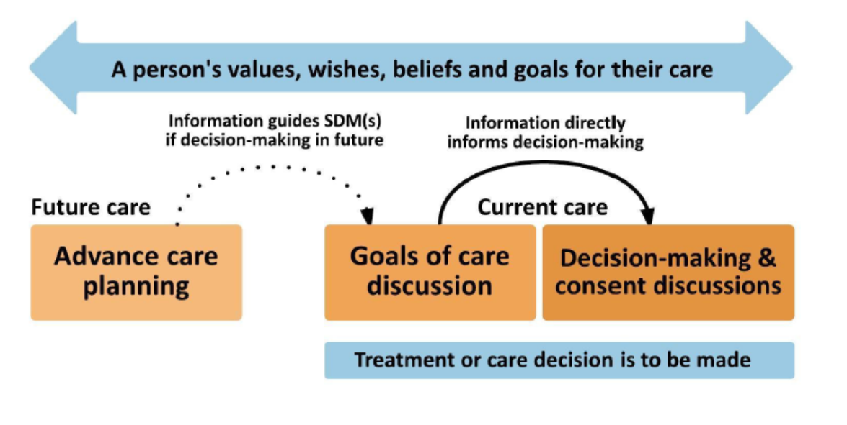
ACP- Future Oriented vs Goals of Care - Present

Slide 18

Why the Ostrich Syndrome?
Notes:
The words we use are very important to create shared understanding and meaning
Many of these terms are borrowed from other jurisdictions and provinces – when we use some of them in Ontario it can create confusion.
If time, ask the audience what they understand about that term to demonstrate how the term can be used/interpreted differently by different people.

Slide 19

Who would speak for you?
http://www.advancecareplanning.ca/what-is-advance-care-planning/

Slide 20
Advance care planning
In Five Simple Steps
THINK
LEARN
CHOOSE/(IDENTIFY)
TALK
RECORD/(REVIEW)
Notes:
The words we use are very important to create shared understanding and meaning
Many of these terms are borrowed from other jurisdictions and provinces – when we use some of them in Ontario it can create confusion.
If time, ask the audience what they understand about that term to demonstrate how the term can be used/interpreted differently by different people.

Slide 21

Project Background
Family medicine resident passionate about ACP- developed information “slide show” on ACP for TVs in our waiting areas
  Vision was that ACP was relevant not just at end of life but across the continuum of life
TOH profiled ACP and the role of Nursing in monthly journal
Presentation to a Nursing Education session by Advance Practice Nurse in Palliative Care* on ACP
April 2016 - Interprofessional task team formed to develop plan for how we could more fully support ACP in primary care
  Representation from patients; physicians; nursing staff and social work
  Goal- develop an interprofessional approach to ACP in our FHT
Notes:
4 controlled acts authorized to nursing (RHPA)
13 controlled acts all together (RHPA)
Treatment not under controlled act – oral medication administration (aspirin for chest pain)
X-rays: the Healing Arts Radiation Protection Act
Lab tests: Laboratory and Specimen collection Center Licensing Act

Slide 22
INITIAL Task Team Activities
Review of existing team member activities related to ACP
  use of “Speak Up” booklet - Memory Clinic
  A few HCPs addressing ACP with patients
Survey of HCPs to determine where ACPs were being stored on the EMR
  “If something happened to you and someone had to take over your practice – where would that person find information on ACP for your patients?”
    Result: Inconsistent practice- no standard location for this information
    Action: ACP EMR template developed and implemented
Complete literature review of ACP in primary care
Notes:
4 controlled acts authorized to nursing (RHPA)
13 controlled acts all together (RHPA)
Treatment not under controlled act – oral medication administration (aspirin for chest pain)
X-rays: the Healing Arts Radiation Protection Act
Lab tests: Laboratory and Specimen collection Center Licensing Act

Slide 23
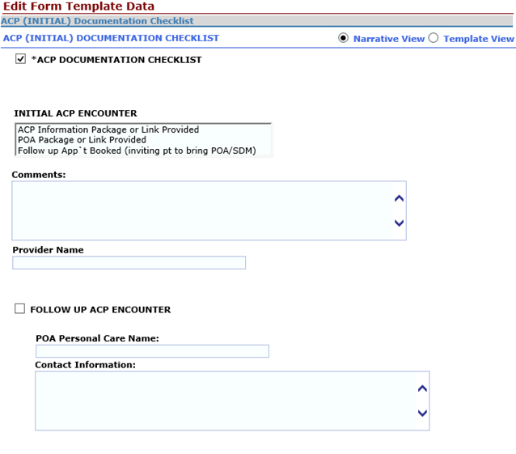
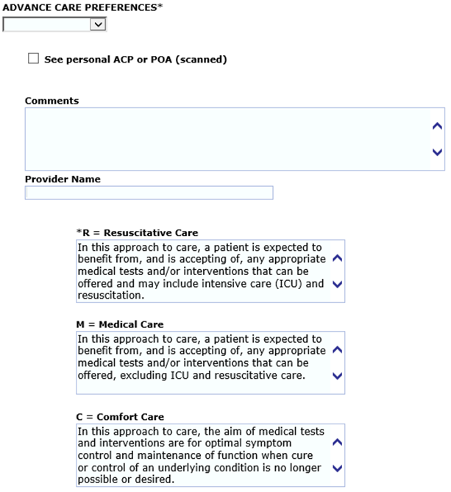
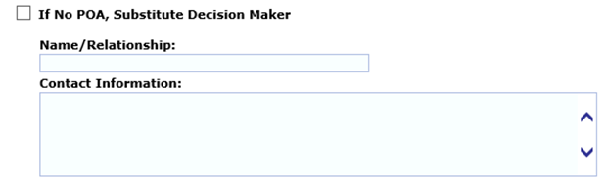
Nightingale ACP template ( initial)
Comfort Care
Medical Care
Resuscitative Care

Slide 24

Advance Care planning
Traditionally, end of life decisions have been made in situations where end of life may be sudden and the individual may not have the mental capacity to participate in decisions³
Increasing awareness to all adults to the process and management of end of life care is an important step in early adoption⁴
Primary health care is the ideal setting for these conversations to take place⁵
Literature Review

Slide 25
Benefits of Early Advance Care Planning
Improved quality of life at end of life⁶
Less in hospital death⁷ and admission to hospitals⁸
Decreased stress and burden of care placed on family and caregivers⁹
High patient satisfaction from physician communication and time spent discussing advance care planning¹⁰
Literature Review

Slide 26
Barriers to Advance Care Planning
Time constraints; discussions can be time consuming
A lack of personal knowledge/expertise
Inadequate health care provider training and comfort with material
Waiting for patients to initiate discussion
Perception that discussion is not important for all adult patients
Cannot find ideal opportunity to initiate discussion
Misinterpreted patient and family reactions to sensitive subject
Emotional or physical state of the patient
Assumption that other team members are discussing
Literature Review

Slide 27
Integrating process into family medicine
ACP is a multifaceted process that involves many conversations taking place over time¹⁴
Features of ACP include understanding patient’s values, beliefs, goals and wishes of care¹⁵
There is a little information regarding the roles of interdisciplinary health care providers in the process of advance care planning¹⁶
Social worker’s have a distinct skill set suggesting possibilities of involvement due to high physician patient rosters and nursing shortages¹⁷
As health care providers, guide patients and their families through the decision making process, the health care providers should provide honest, direct and realistic information¹⁸
Literature Review

Slide 28
current status of ACP among Health care teams and patients
Very limited Canadian literature on the current status of advance care planning engagement
One study evaluating rates of communication, showed 69.9% of family medicine physicians advised patients to communicate their future health care wishes
Physicians initiating an End of Life discussion- only happened in 1% of encounters in a non-palliative family medicine setting
Evidence consistently shows low population engagement in the process of carrying out advance care planning
Literature Review

Slide 29
Education
The Speak Up campaign is a Canadian wide initiative, intended to implement ACP and provide appropriate resources and tools to effectively engage patients and their families
Few formal end of life education programs for physicians, nurses and social workers
Two programs were identified:
  The Practice Support Program is a continuing medical education program offered to physicians and health care providers of British Columbia, Canada²³
    http://www.gpscbc.ca/what-we-do/professional-development/psp/modules/end-of-life/tools-resources
  My Health. My Wishes: An Advance Care Planning Primer and Practical Approaches for Healthcare providers
    East Toronto Health Link- 4 modules- best accessed through the Canadian Virtual Hospice website
Literature Review

Slide 30
Task Team ActiviTies
Develop algorithm outlining various roles of the interprofessional team
Recognize developing an ACP is a process that often involves multiple conversations where different team members may be able to help sort out issues
Ideally conversations occur early- prior to a health crisis, while the patient is still competent
Notes:
Physician order for b12 IM injection
Allergy desensitization

Slide 31
Nurse’s Role in ACP
College of Nurses of Ontario Practice Standard
  Guiding Decisions about End-of-life Care (2009)
Nurses have a role in:
  Communicating with patients and the interprofessional team regarding end of life care wishes
  Ensuring patients have sufficient information to make an informed decision about end of life care and resuscitation
  Identifying and advocating for patients wishes
  Documenting patients wishes in the health record
  Implementing patients’ wishes according to the plan of care
Notes:
4 controlled acts authorized to nursing (RHPA)
13 controlled acts all together (RHPA)
Treatment not under controlled act – oral medication administration (aspirin for chest pain)
X-rays: the Healing Arts Radiation Protection Act
Lab tests: Laboratory and Specimen collection Center Licensing Act

Slide 33
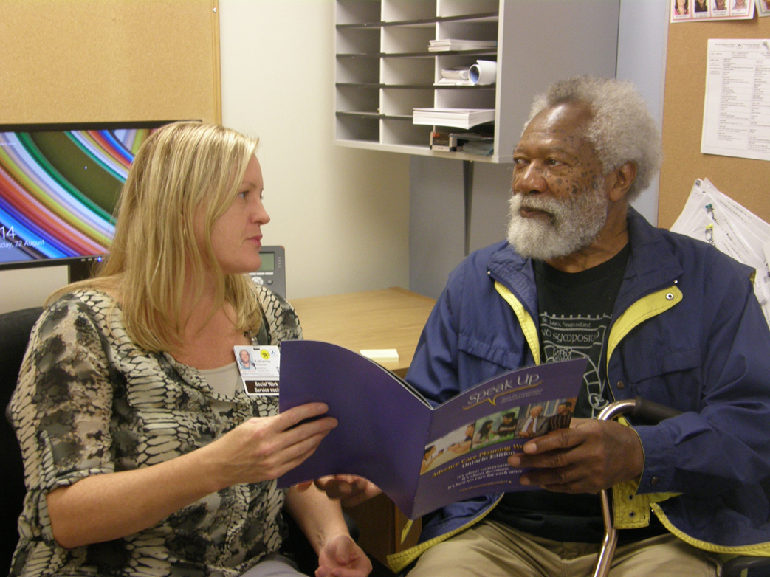
Patient/ Family Communication
Slide show on TV’s in FHT lobby
Patient mail out: ACP brochure

Slide 34
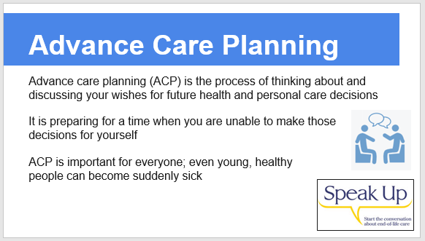
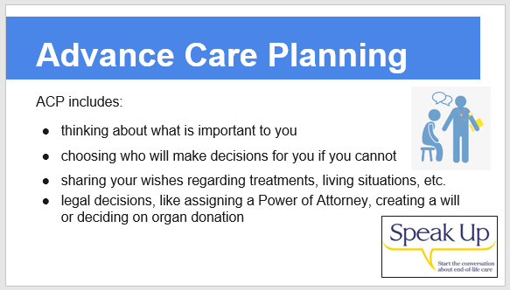
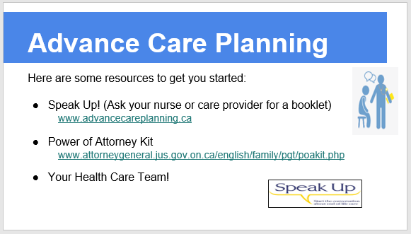
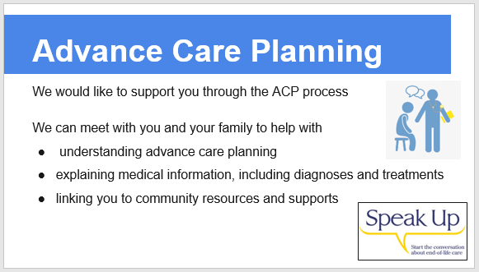
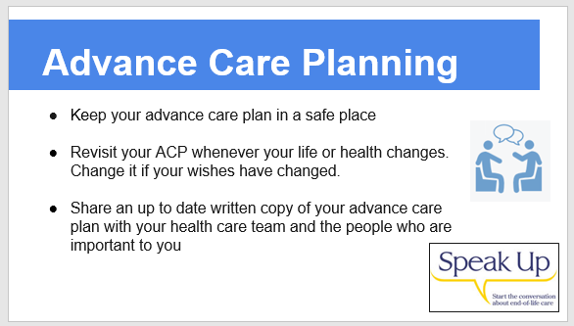

Slide 35
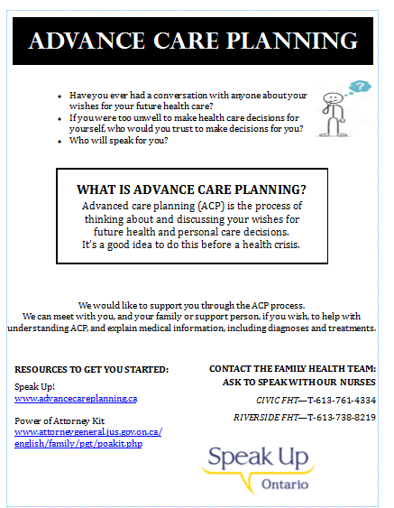
Fall 2017- Flyer included with Flu mailing to all patients age 65 and older

Slide 36

Team Education
Task team reviewed existing resources:
    “ Speak Up”- www.advancecareplanning.ca
    End Of Life Planning Canada, “ Who Will Speak for You: Advance Care Planning Kit, Ontario Edition” (Feb 2016)
    East Toronto Health Link – My Health My Wishes- 4 modules
  Nursing Education
    External clinical experts in ACP conversations from the LHIN ( Palliative care )
    Reviewed terminology; key principles; resource materials
    Role play- initial demo; participant practice
Notes:
Physician order for b12 IM injection
Allergy desensitization

Slide 37
Team Education
Entire team – presentation ( 15 minutes) at CQI meeting; ACP poster shared
Physician Education:
Reviewed results of survey
Demonstrated use of Nightingale template
APN – Lunch and Learn
Reviewed Interprofessional Algorithm and support various team members could provide
Concerns raised re: patient mail out and potential for increased workload; long appointments etc. and whether it was part of their role
Reassured that if there was an overwhelming response – a group session would be offered by our social worker; nursing staff
Notes:
Physician order for b12 IM injection
Allergy desensitization

Slide 38
Progress to Date
Official Launch- November 2017!
Haven’t been overwhelmed with patient calls and requests for appointments
Some physicians are referring patients to nursing staff to begin the process
Nurses are starting to feel comfortable with beginning the conversation, providing resources and documenting on the template; barrier- workload/falls off the radar- so many competing priorities
A few clinical stories…
  Patient arrives with “My Wishes” document from lawyer
  Complex frail elderly patient living alone with no POA identified
  Patient’s daughter sends in “Instructions for Firefighters/First Responders” noting a “DNR” – wishes it to be on FHT EMR for her father
  INR patients
  82 M: seen in Memory clinic, Hx: MCI, Parkinson's, religious differences with POA around end of life/MAID

Slide 39
Let’s practice !

Slide 40
Scenarios
Healthy Patient – interested in ACP- I saw the information on the TV screen
New Diagnosed with Cancer – “I don’t want to go through what Mum went through. (pain, loss of dignity/starvation) I don’t want my kids to have to see that.”
Chronic Illness ( COPD) – “The doctor told me to talk to you. Was in to see her because I was really short of breath. Having more trouble breathing. I can’t even take the dog for a walk most days”….

Slide 41
Starting The Conversation
Tell me- what brings you here today?
What do you understand about advance care planning?
I need to ask you several questions to find the best way to help you, and I need to hear your questions and concerns as well.
Can you tell me a little about what is prompting your interest in advance care planning?
Have you completed a Power of Attorney for Personal Care and named a Substitute Decision Maker?
Have you shared your wishes, values and beliefs around health care decisions with your SDM?
Our discussion today is only a beginning. We can take this at your own pace.
What do you mean when you say: I don’t want to be a burden; I want to die with dignity; I don’t want to die the way my mother did..
* Adapted by East Toronto Health Link from © Gundersen Lutheran Medical Foundation
Notes:
Physician order for b12 IM injection
Allergy desensitization

Slide 42

Next steps
Develop evaluation plan
  Patient satisfaction with process
  Staff satisfaction with process/resources etc.
  Timeliness of plans
Notes:
Physician order for b12 IM injection
Allergy desensitization

Slide 43
Resources
Speak Up Program – Ontario* program
My Health, My Wishes Program
  Interview guides:
    General situation
    Patients with chronic illness
    Patients in Long Term Care and within last 12 months of life
  Video scenarios
Linda Lee Memory Clinic: specific resource for patients/families
Others- local experts?

Slide 44
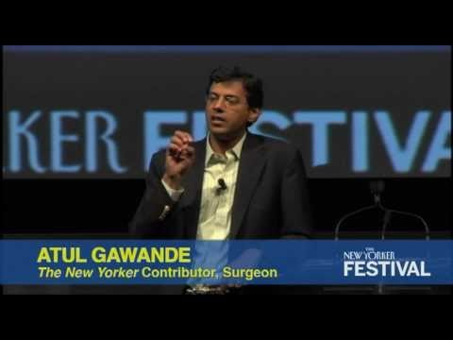
Atul Gawande- Author of “Being Mortal”
https://www.youtube.com/watch?v=45b2QZxDd_o

Slide 45

A special thankyou to Vince Gilpin, our patient representative, who generously volunteers his time to work with us.
Contact Information: Vicki Bassett, Nurse Educator vbassett@toh.ca

