Slide 1
One pill a day, can keep HIV away
Presented by Daniel Bois, RN

Slide 2
Welcome & Who Are We?
The Health Centre at 410, St. Michael’s Hospital: approximately 18,000 patients
St. James Town: 17,000 residents in 19 apartment towers and 4 low rise buildings: one of Canada's most densely populated communities
Our population: new immigrants to Canada, homeless and under-housed, LGBTQ community
Our HIV+ population: approximately 900 patient, 1,350 Department wide
Social determinants of health intersecting

Slide 3
Acknowledgement

Slide 4
Warm Up. Retrieved from https://www.youtube.com/watch?v=Si0JJE1rXWY

Slide 5
Outline
The state of HIV
Why HIV prevention is important?
What is HIV Pre-Exposure Prophylaxis (PrEP)?
Engaging in a conversation

Slide 6
HIV in Canada
75,000 are Canadians living with HIV
20% are unaware of their infection
Question: what are contributing factors?
Men who have sex with men (MSM) represent more than half of the HIV prevalence in Canada (CATIE, 2014)

Slide 8
HIV in Ontario
Males represent 80% of the HIV+ population
In 2015, the majority of people with diagnosed HIV living in Ontario were residing in:
Toronto(54.3%)
Central East (12.1%)
Central West (10.5%)
Ottawa (10.2%)
South West(6.8%)
Eastern (3.3%)
Northern (2.8%) (Ontario HIV Epidemiology and Surveillance Initiative [OHESI], 2015)

Slide 9
In the News: HIV in Ontario
“London declares 'health emergency' over rise in HIV and hepatitis C” retrieved from http://www.cbc.ca/news/canada/windsor/london-health-emergency-hiv-hepatitis-1.3634849

Slide 10
HIV in Toronto
23% of MSM living in the City of Toronto are HIV+ (CATIE, 2017).
20% approximately are unaware of their infection

Slide 11
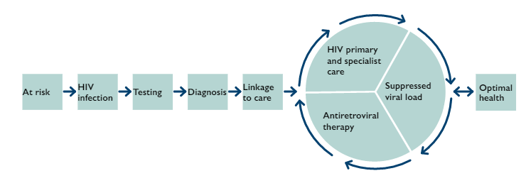
HIV Prevention: Treatment Cascade of Care
Image retrieved from http://ohesi.ca/documents/HIV-care-cascade-age-sex-health-region.pdf

Slide 12
“Easier said than done” example

Slide 13
Defining “at risk”
MSM and transgender women who report condomless anal sex:
Frequent STIs
Frequent use of Post Exposure Prophylaxis (PEP)
Sexual encounters with others who are at risk for transmitting HIV
Sero-discordant partners who report condomless anal and vaginal sex (Tan et al., 2017).
Question: anyone else at risk?
NOTE: the PrEP guidelines are listed in the reference list

Slide 14
What is Pre-Exposure Prophylaxis (PrEP)?
Video retrieved from http://www.whatisprep.org/

Slide 15
PrEP key points
HIV prevention strategy for both men and women
Safe and effective
Offers over 90% protection
Daily adherence is highly recommended
Baseline HIV test and normal kidney function
Regular testing (every 3 months) for HIV, other STIs, and kidney function

Slide 16
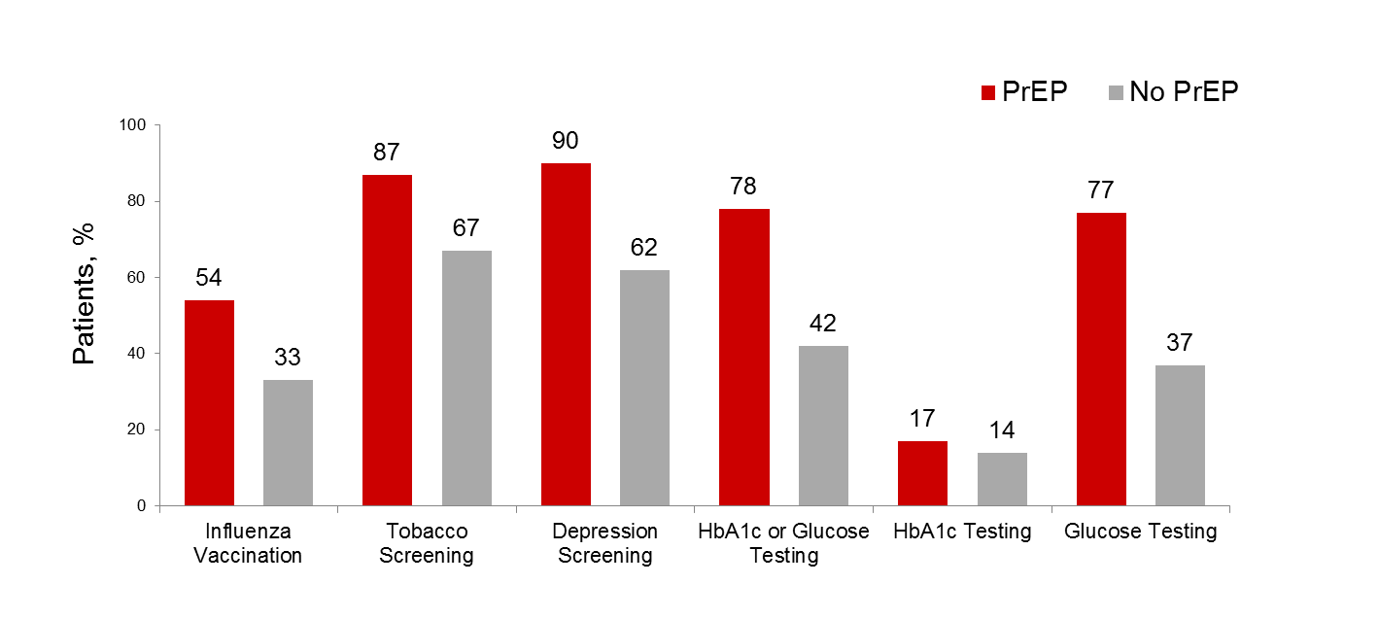
PrEP as a Gateway to Primary Care
Cross-sectional study of PrEP vs. non-PrEP users at Fenway Health to determine association of PrEP with receipt of routinely recommended primary care (N=5,857) (Marcus, 2018).

Slide 17
How to access PrEP?
Private Insurance (and a small, potential risk for refusal)
ODB
Trillium

Slide 18
How to talk PrEP?
Sexual health care and the 3 paradigms of nursing:
Empirical
Interpretive
Critical
Pragmatism: working with multiple paradigms simultaneously to address a greater variety of human conditions, resulting in authentic, reciprocal human connections in a world that is complex, layered, and dynamic.

Slide 19
How to talk PrEP?
Empirical: learn about the science and have resources by your side (we can’t know and do everything perfectly in primary care)
Interpretive: navigating intimate topics within the therapeutic relationship
Critical: systems navigation and patient advocacy

Slide 20
boisd@smh.ca
THANK YOU!

Slide 21
References
CATIE. (2011). New HIV Infections in Canada. Retrieved from http://librarypdf.catie.ca/PDF/ATI-40000s/40239.pdf
CATIE. (2014). The epidemiology of HIV in Canada. Retrieved from http://www.catie.ca/en/fact-sheets/epidemiology/epidemiology-hiv-canada
CATIE. (2017). The epidemiology of HIV in gay men and other men who have sex with men. Retrieved from http://www.catie.ca/en/fact-sheets/epidemiology/epidemiology-hiv-gay-men-and-other-men-who-have-sex-men
East, L., & Hutchinson, M. (2013). Moving beyond the therapeutic relationship: a selective review of intimacy in the sexual health encounter in nursing practice. Journal of Clinical Nursing, 22, 3568-3576, doi: 10.1111/jocn.12247
Evans, D. T. (2013). Promoting sexual health and wellbeing: the role of the nurse. Nursing Standard, 28(10), 53-57.
Marcus, J. L. (2018). HIV Pre-Exposure Prophylaxis as a Gateway to Primary Care. CROI: Poster 1011. Boston: MA.
Ontario HIV Epidemiology and Surveillance Initiative. (2015). HIV Cascade of care in Ontario by sex, age health region: Linkage to care, in care, on antiretroviral treatment and virally suppressed, 2015. Retrieved from http://ohesi.ca/documents/HIV-care-cascade-age-sex-health-region.pdf
Tan et al., (2017). Canadian guideline on HIV pre-exposure prophylaxis and nonoccupational postexposure prophylaxis. Canadian Medical Association Journal, 189(47), 1448-1458.
Whatisprep.org. (n.d.). What is PrEP? Retrieved from http://www.whatisprep.org/

