Slide 1
Why does money matter anyways?
Advocating for Income Supports to Reduce Poverty and Improve Health
Alyssa Swartz MSW RSW
Chloe Walls MSW RSW

Slide 2
Presenter Disclosure
No specific conflicts of interest or financial disclosures.
We approach this work from a privileged position as a health care providers. We do not speak on behalf of people living in poverty; we speak as allies.

Slide 3
Presenter Acknowledgements
We would like to thank:
Janet Lee-Evoy PGY5,
Dr Michaela Beder, Dr Andrew Pinto, Dr Gary Bloch, the St. Michael’s AFHT Social Determinants of Health Committee, and the Upstream Lab.
We would also like to acknowledge Woodgreen Community Services for their RESP info sheets.

Slide 4
Objectives
Discuss how poverty affects health and mental health
Explore specific interventions to reduce poverty and improve health in clinical practice
Provide practical tips and strategies to help advocate for income supports for our patients
Provide a practical approach to incremental income interventions for the RESP.

Slide 5
WHAT MAKES US SICK?

Slide 6
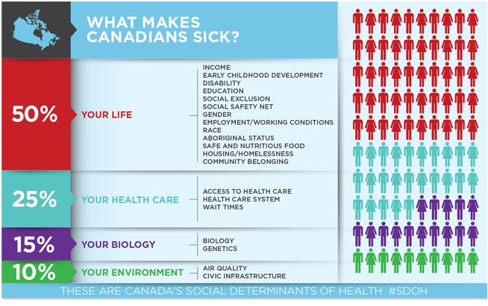

Slide 7
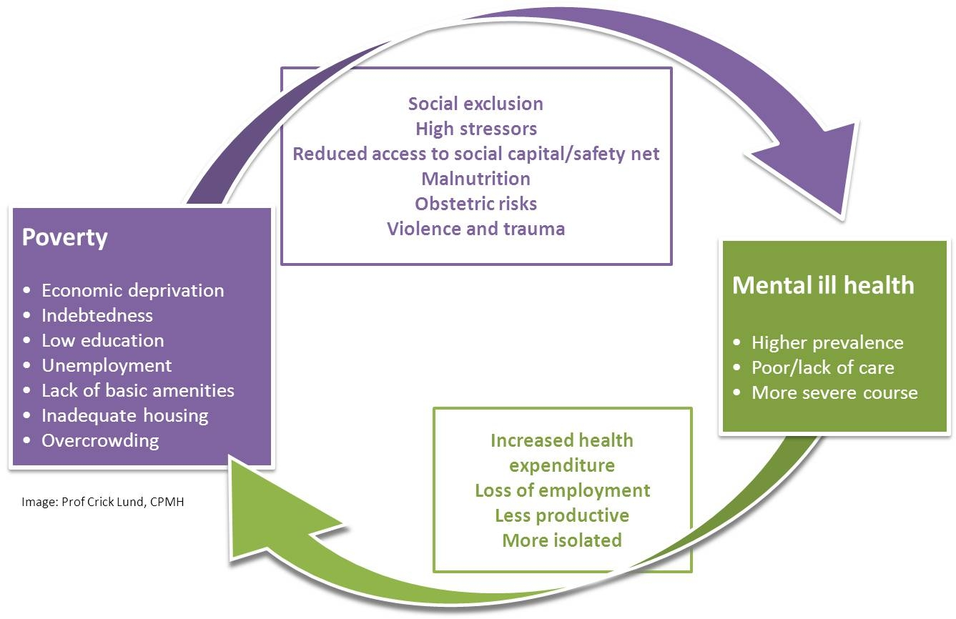
Lund, C. (2017). Perinatal Mental Health Project. University of Capetown. Retrieved November 27 2017 from https://pmhp.za.org/resources/mmh-facts/consequences/
Notes:
Lund, C. (2017). Perinatal Mental Health Project. University of Capetown. Retrieved November 27 2017 from https://pmhp.za.org/resources/mmh-facts/consequences/

Slide 8
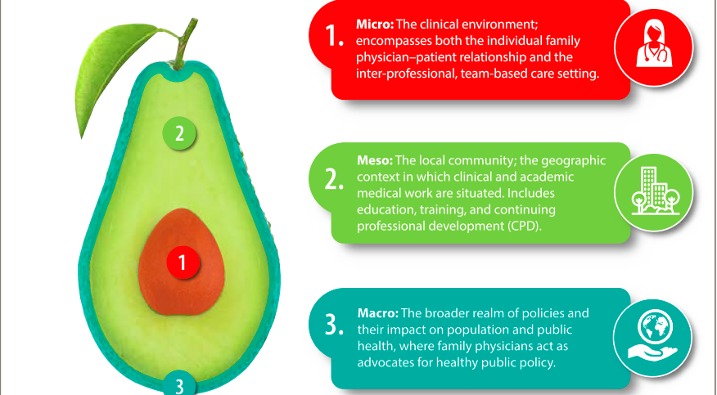
Micro/Meso/Macro
Buchman S, Woollard R, Meili R, Goel R. Practising social accountability. From theory to action. Can Fam Physician 2016;62:15-8. (Eng), 24–7 (Fr).
Notes:
Intervening in poverty and MHI

Slide 9
Income Security Health Promotion
Program through St. Michael’s Hospital
Collaboration on a community level to provide education and training opportunities for cross discipline professional development on income related issues.
Members of the Social Determinants of Health Committee at St. Michael’s Hospital.
Actively engaged in the SDOH committee’s advocacy subcommittee, promoting meso and macro level advocacy efforts.
Notes:
Meso Level Intervention

Slide 10
Income Security Health Promotion
Train providers in income security interventions such as filling out applications and understanding which income support system may be most beneficial to their patients.
Guide patients through relevant income support programs and provide continuity through the income support process and beyond.
Provide time limited financial case management.

Slide 11
Income Security Health Promotion
Staffed by 2 full time Health Promoters with experience in income support, program design, evaluation, and tenacity.
NOT ONLY about filling out forms, it is about advocating, educating, and empowering our patients to take care of their income.
Focuses solely on income as one of the key social determinants of health.

Slide 12
Income Security Health Promotion
Patients are provided with one on one appointments, group workshops, and a focused intervention that works on a 3 pronged approach:
a) Increasing Income
b) Reducing Expenses
c) Increasing Financial Literacy

Slide 13
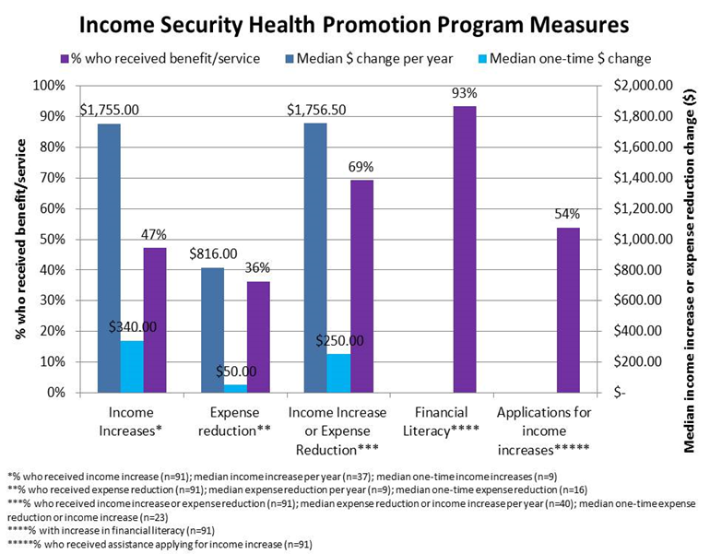
The facts on income security
Notes:
Schedule A measures

Slide 14
Income Security in Action
The story of James

Slide 15
Case: James
19 year old Caribbean- Canadian male
Born in Toronto, normal developmental history, did well in school
No medical issues
Family history of depression in father
Notes:
Micro Level

Slide 16
Case: James
Seen by family doctor for “anxiety and depression” after he unexpectedly left his job, saying it was “too stressful”
Diagnosed with MDD
APPLY FOR EMPLOYMENT INSURANCE SICK BENEFITS (EI-SB)
Notes:
Psych assesment not necessary any Dr can complete EI SB

Slide 17
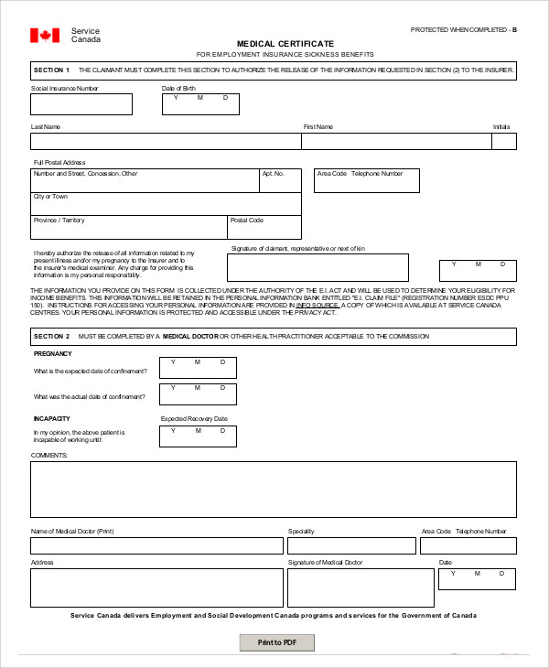
EI-Sick Benefits
Eligibility: Insurable employment in past year
55% of wages for up to 16 weeks max $543 weekly
Easy 1 page form

Slide 18
Case: James
Start antidepressant medications but no drug coverage through work
Encourage James to apply for Ontario Works which is rejected until EI-SB runs out, but MAY still provide drug card
If Ontario Works is rejected a Trillium Drug Benefit application should be made

Slide 19
Ontario Works
$706/month (approx)
Eligibility: Anyone in financial need living in Ontario
Takes less than 5 days if ALL documents submitted
Not done by physician

Slide 20
Case: James
Pt stops sleeping, is euphoric, thinks he has a business plan in China that will make him millions of dollars, and is stopped at the airport after trying to fly to China without a passport or visa
Brought to St. Mike’s ER and diagnosed with Bipolar I. Remains symptomatic despite treatment
Unable to continue work at this time
Application for ODSP

Slide 21
Ontario Disability Support Program
Tips:
List all conditions
Impairment = symptoms
Restriction = disability
Must have duration >1yr
Prognosis = “unknown” or “guarded” if unsure
Attach consult notes
$1,128 (approx)
Drugs, Vision, Dental
Eligibility: Substantial impairment restricting ability to work/live/participate in community, continuous or recurrent and expected to last over 1 year

Slide 22
Case: James
ODSP approved with 5 year review date
18 months later, pt has recovered and is stable on medications
Decides to apply for university and is accepted
Supported by ODSP for living expenses and OSAP for tuition

Slide 23
Case: James
After graduation, returns to work. Still has episodic relapses, but has supportive employer and overall is doing well
Slow transition off ODSP until he finally has permanent work as well as drug benefits
Received extended drug benefits for 1 year following being off ODSP financial support
Notes:
Slow transition off ODSP. Jame’s income assistance is reduced by 50 cents for every dollar he earns. At the height of his employment there may be months where he receives no entitlement for money but receives drug coverage. Eventually he has several months with zero income assistance and is transitioned off ODSP income supports but maintains drug coverage, dental coverage and eye care.

Slide 24
Working on ODSP - “The sales pitch”
$500 a month earnings: ODSP’s “sweet spot”
- Your patient earns $500 this month after taxes.
- ODSP allows them to keep the first $200 and deducts 50% of the remaining $300 or $150.
- ODSP provides them with $100 per month for work related expenses.
- In the end ODSP has only taken $50 off the patient’s ODSP cheque
- Patient has a net gain of $450 for working.

Slide 25
Case: James
Work going well, and pt decides to start saving for retirement/illness planning
Asks his nurse about Disability Tax Credit, and family physician assists in the application
Initially rejected, but approved on reconsideration
Notes:
Pt hears about DTC from National Benefits Authority which takes 30% of it if approved!
Many claims initially rejected but high rates of approval on reconsideration

Slide 26
Disability Tax Credit (DTC)
10K tax credit
Allows you to open a Registered Disability Savings Plan (RDSP)
Government will contribute $3 for your $1 contribution plus a $1000 yearly grant (if income under 30K annually) up until age 49

Slide 27
Disability Tax Credit - Tips and Tricks
Look at cumulative effect of multiple impairments.
Patient may only be markedly restricted in a number of areas which taken together provided substantive impairment.
Include supporting documentation or a letter of support.
Notes:
Re mention lembi website

Slide 28
Case: James
15 years stable employment with small lapses due to recurrent illness
At age 47, however, stopped medications and has major relapse resulting in hospitalization and ultimately loss of employment
Denied Long Term Disability due to pre-existing condition clause
Next step to re-apply for ODSP

Slide 29
Case: James - ODSP Eligibility
Pt has 60K in RRSP and 80K in RDSP
ODSP eligibility asset limit is 40K for a single person (up from 5K in September 2017)
RDSP is not considered an asset, but still too much money in RRSP to apply for ODSP
CAN apply for CPP-D

Slide 30
Canada Pension Plan - Disability
Eligibility: Contributed to CPP in 4 of 6 years, age UNDER 65, severe and prolonged disability
Disability: Medical condition which prevents work at any job and unlikely to improve
Apply even if uncertain
Include ALL medical issues
Detail functional restriction
Detail treatments/referrals
Prognosis with uncertain time frame
If denied, likely approved on appeal

Slide 31
CPP-D Reconsideration Process
INCLUDE IN LETTER
symptoms and diagnosis;
limitations and restrictions;
medications and treatments and their effectiveness;
dates of disability;
prognosis; and
whether medical condition(s) prevent(s) patient from being gainfully employed and attach updated medical

Slide 32
CPP-D Reconsideration Letter
In summary, James suffers from severe, prolonged, and chronic mental illness, and the
prognosis for any improvement in level of functioning is poor. I am not aware of any other treatment modality available today that is likely to change the clinical picture for this patient.
James is unable to maintain any type of employment. In regards to retraining or the
possibility of performing light work, I feel that James’s limitations are not a result of lack of
education or training, but instead a direct result of his psychiatric condition. In my opinion, James is not capable of working regularly.
I support James’s appeal to receive CPP Disability benefits based on the severity of illness, the prolonged nature of illness, and the fact that I believe they are functioning at the optimum level given the treatment options available. It is evident that James’s psychiatric disability prevents them from pursuing any substantial gainful occupation.

Slide 33
Case: James
CPP-D is initially rejected
CPP-D reconsideration letter sent and CPP-D is approved
James receives $1080/month (results vary, contribution based)
Applies to Trillium Drug Benefits for drug coverage
During this time RRSP savings depleted to 30K (so now eligible for ODSP)

Slide 34
CPP-D and ODSP
Apply for Both!!
ODSP provides:
drug benefits, dental care, eye care
Mandatory Special Needs Form (transportation, diabetic supplies)
Special Diet Form (e.g. obesity, diabetes, wasting)
If you have been approved for CPP-D you medically qualify for ODSP
Notes:
Speak about how, because of our drugs, pt has bad teeth (dry mouth) and diabetes and obesity

Slide 35
Case: James
After applying for ODSP rate is now calculated at $1278 (basic needs, shelter, transportation and special diet and diabetic supplies)
Compared to CPP-D entitlement of $1080, James’ monthly income has now increased by $198/month! Plus drug/dental/eye coverage

Slide 36
Life Goes On...

Slide 37
Happy 64th Birthday James!
At 65 he will lose ODSP and CPP-D
Now time to apply for CPP, OAS GIS
CPP- Canada Pension Plan
OAS Old Age Security
GIS Guaranteed Income Supplement
Apply one month after your 64th birthday
ODSP does not offer formal assistance in this process.

Slide 38
But wait there’s more - His RDSP!
He was contributing $40/month for 15 years, matched by government contributions of $120/month
Government grants since opening until age 49 (17 years)
RDSP contains $45,800 (not including investment income)
$38,600 of this was government grants (will contribute a max of $70,000)
That’s extra money he can use now!

Slide 39
Incremental Income Security Work
Small Steps…BIG Impact:
A step by step guide to the RESP

Slide 40
What is an RESP?
A Registered Education Savings Plan (RESP), is a special savings account to help save money for your child’s education after high school.

Slide 41
What is an RESP?
Registered Education Savings Plan (RESP)
RESP
Canada
Learning Bond
(CLB)
Canada Education Savings Grant (CESG)

Slide 42
What is the Canada Learning Bond?
“free money” that the Government of Canada directly deposits into the RESP of eligible children

Slide 43
What is the Canada Education Savings Grant?
money offered by the Government of Canada to match any contributions made to a child’s RESP.

Slide 44
Why Is It Important?
Children with Education Savings are:
3 times more likely to attend education after high school.
Scholarly research on children’s savings accounts. CFED 2014.
4 times more likely to graduate from that program.
Scholarly research on children’s savings accounts. CFED 2014.

Slide 45
Incremental Approach
Introduce RESP – provide handout ‘what’s this all about’
Check in – has the patient already applied? If not, what is the concern? SIN number? Bank appointment process information? Provided additional information if necessary.
Check in – has the patient applied? If so have they received their CLB grant if they are eligible? If not why? What barriers are they facing and how can these be addressed?
Yearly Check in – Have you completed your taxes this year? Have your checked your RESP balance in the last 6 months.

Slide 46
Incremental Approach
Special Circumstances: Newborns
As of March 2018, Ontario has transitioned from the 4-in-1 Baby Bundle to the 5-in-1 Baby bundle for birth registrations
This means RESP information will be gathered when people register their child’s birth and a financial institution will follow up with the parent/guardian who registers the birth
Important to discuss the risks of private RESP institutions that may have forced, contributions and hidden fees

Slide 47
QUESTIONS FOR OUR INCOME EXPERTS?

