Slide 1
Mifepristone for Medical Abortion
What Nurses Need to Know
Melanie Spence, RN, BScN, BA(Hon)
Sarah Warden, MSc, MD, CCFP

Slide 2
Disclosure & Affiliations
Relationship with Commercial Interests: none
Melanie Spence – RN currently at CHC, formerly at the Bay Centre for Birth Control
Sarah Warden – Lead Physician, Mifepristone Program, Bay Centre for Birth Control, Women’s College Hospital

Slide 3
Objectives:
At the end of this presentation, attendees should be able to:
Discuss the pros/cons of Mifepristone/Misoprostol related to other options for first trimester pregnancy termination
Describe Mifepristone/Misoprostol regimen and understand common side effects and expected outcomes
Identify opportunities for integrating Mifepristone/Misoprostol provision into their family practice settings!
Notes:
MEL

Slide 4
Why Medical Abortion?
Abortion is common
  Almost 1/3 of women will have at least one abortion in her lifetime
  >25,000 in Ontario per year (CIHI 2015)
Improved access to care
  More providers (primary care providers)
  Remote access
Highly acceptable
  Greater privacy
  Partners do not need to know that abortion not spontaneous
  80-95% of patients would choose the method again or recommend the method to a friend
Swica Y et al, (2011) Expert Rev Obstet Gynecol 6.4
Notes:
MEL
In countries that have introduced mife, proportion of medical abortions has gone up significantly most notably in Europe, where in some countries the proportion of patients having medical abortions is 75-90%
Satisfaction rates comparable to surgical

Slide 5
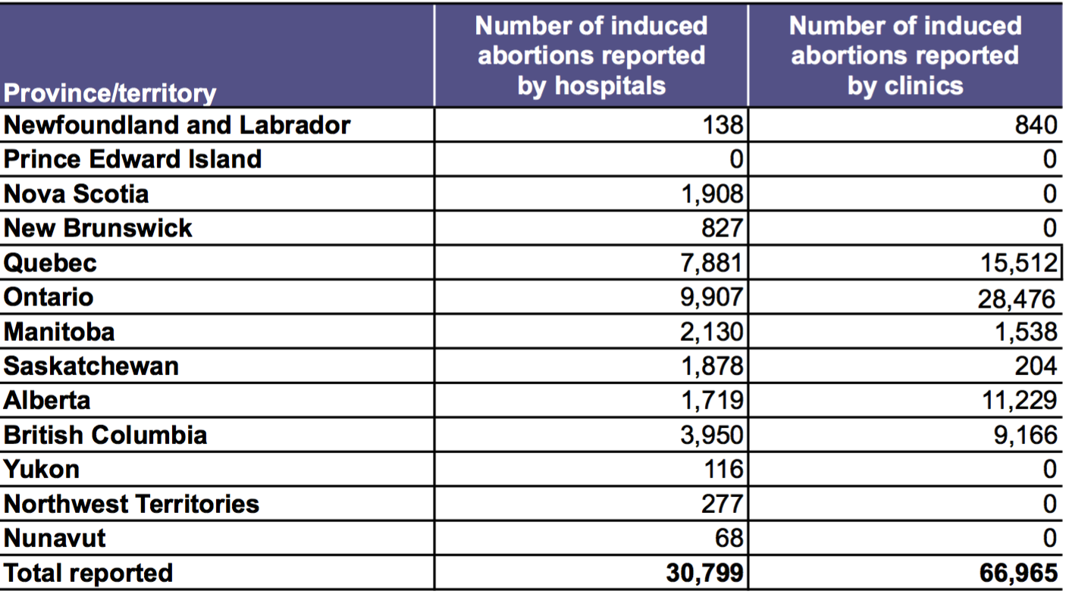
Number of Induced Abortions in Canada, 2016 by province/territory, by hospital or clinic
https://www.cihi.ca/en/quick-stats
Notes:
MEL
Nearly a third of women will have an abortion in their lifetime
Access to abortion varies across the country
PEI just started performing abortions in one hospital
- many provinces only have abortions available in hospital, not in clinics which has a significant effect on access

Slide 6
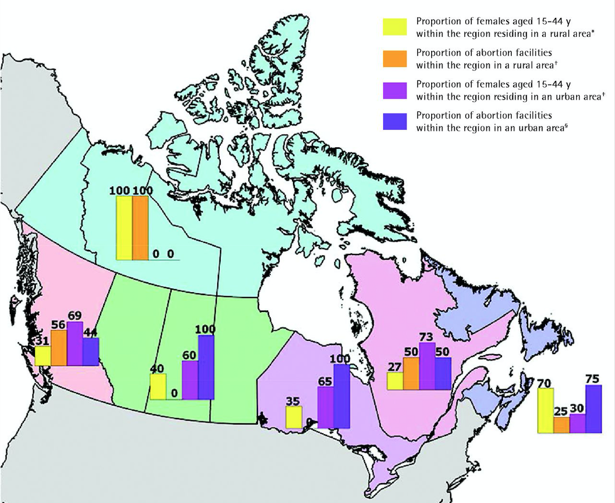
Distribution of Abortion Facilities in 2012
QC/BC: abortion services equal rural vs urban
None in PEI until 2017
Rest of Canada mostly urban provision of abortion
Norman WV, Guilbert ER et al. Can Fam Physician 2016.62: e209-17.
Notes:
MEL
PEI has started performing surgical abortions in one hospital since February

Slide 7
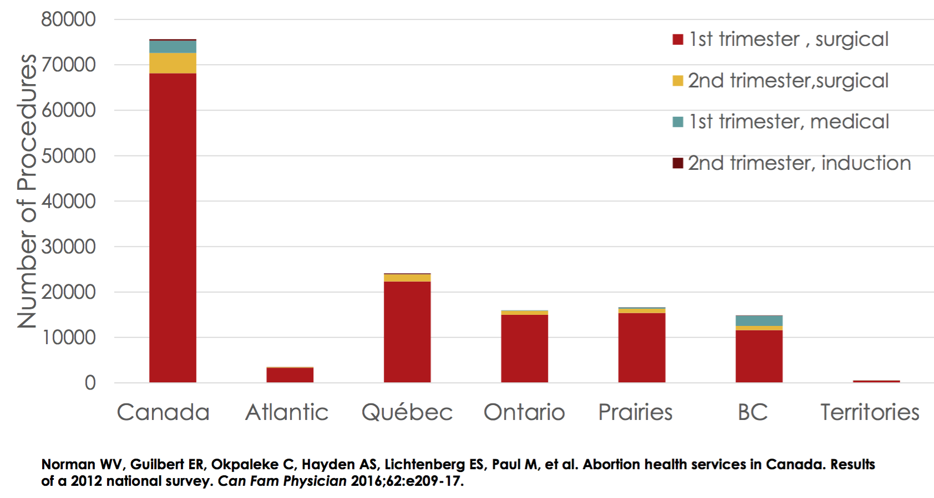
Abortions in Canada by type, 2012
Notes:
MEL
As of 2012, vast majority of abortions performed were surgical, BC was the only province providing much in the way of medical abortions.

Slide 8
Key features in decision making
Medical Abortion (MA) | Surgical Abortion (SA)
Highly effective/acceptable | Highly effective/acceptable
Avoids surgery, usually more pain and bleeding | Sedation/anesthesia may be available
Can take days to weeks to complete | Completed rapidly
Heavy bleeding, more than a period | Light bleeding
Private | Less privacy, may require escort due to anesthesia/sedation
Support person can be present | Support person may not be allowed in during procedure
May be shorter wait | May be longer wait
Clinic or office | Hospital or abortion clinic
May be more than 2 visits | Usually one to two visits
Notes:
MEL
Privacy may equal safety for some patients
Less time away from families

Slide 9
Key statistics of MA vs. SA
Key Outcome | Medical Abortion (MA) *Mife | Surgical Abortion (SA)
Completion rate, not requiring further intervention | 95-98% | 99%
Surgical Aspiration rate | 2-5% | Less than 1% re-aspiration
Ongoing pregnancy | 0.5 – 0.9% | Less than 1%
Infection rate | 0.92% | 0.5%
Gestational Age Limit (Health Canada) | 9 weeks | Varies by centre, up to 24 wks
Cost | No cost (OHIP/Fed health programs) | No cost for procedure
SOGC Guidelines: Medical Abortion 2016
Notes:
MEL
MA considered as safe and effective as SA before 7 wks
Cost for surgical – no cost for procedure itself but may be a charge in some clinics, cost of travel, lodging depending on how far pt is travelling

Slide 10
Methotrexate and Misoprostol
OFF LABEL for both medications
MTX: blocks enzyme required for cells to grow
GA up to 7 weeks
MTX 50 mg/m2 IM
Misoprostol 800 mcg 4-7 days later, repeated in 24 hours
Follow up 2 weeks later with u/s, exam
Success rate 87 - 95% by 30d
Used to treat ectopic pregnancies
Notes:
SARAH
Neither MTX or miso indicated for medical abortion, so used ‘off label’
Regimen at BCBC

Slide 11
Notes:
SARAH – discuss briefly

Slide 12
Experience at BCBC:
April 2016 – March 2017:
1853 assessments
MTX: 58/1853 = 3% of abortions
March 2017 – December 2017:
1344 assessments
Mife: 540/1344 = 40% of abortions
MTX: 2/1344 = 0.09% of abortions*
*2 MTX cases before OHIP coverage
Notes:
SARAH
Mife program started in March 2017
OHIP coverage started in August 2017

Slide 13
History of Mifepristone for MA
Mifepristone first approved in France in 1988 “RU-486”
Now gold standard for medical abortion worldwide, available in 62 countries approved between 1988 and 2015
WHO List of Essential Medicines
“Mifegymiso” (Celopharma) = Mifepristone + Misoprostol
Notes:
MEL
WHO essential medicine – the most effective and safe medications needed in a health system

Slide 14
Rollout in Canada
  2015: Health Canada approved
  Multiple barriers:
  49d gestational limit
  Physician stocking, dispensing
  Physician consent and prescription
  Mandatory online training modules
  Observed treatment
  Requirement for ultrasound
  Significant cost to patients
Notes:
MEL (timeline – when training program live, when first offered)
Delay from 2015-2017 partly due to need for training program which wasn’t yet completed, has been criticized as being more stringent than prescribing for narcotics, methadone.
HC further clarified their position that ‘physician supervision/administration’ just meant that a physician was responsible for the overall process and had to consent the patient, not that they needed to directly witness the patient taking med.
- thanks to strong advocacy by leaders in the medical and reproductive health community, many of these restrictions have been lifted with the new amendment

Slide 15
November 2017: Updates
Currently:
Use up to 63d gestation
Pharmacist dispensing
Health Professional prescribing
Training program not mandatory
Registration with Celopharma not required
Written informed consent not required
Ultrasound dating still required
Notes:
MEL
College of Pharmacists and CPSO came out with joint statement that supported pharmacist dispensing
College of Nurses of Ontario supported NP prescribing before this came out

Slide 16
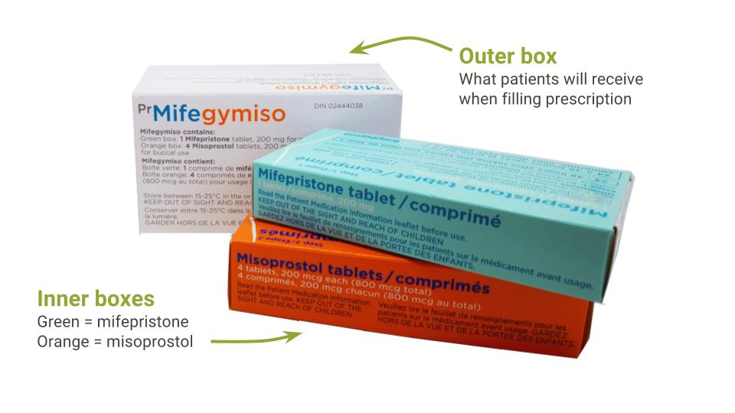
Mifepristone/misoprostol regimen:
Mifepristone 200 mg PO in clinic or at home
Misoprostol 800 mcg buccal* 24-48 hours later
*OFF LABEL: vaginal miso has similar pharmacokinetics, may have less side effects, can use 6-72 hours after mifepristone
Notes:
SARAH
We have been giving mife in clinic, however we are planning to transition to at home administration
Monograph indicates buccal route, mainly due to hx of serious clostridial infections (very rare but high mortality rate)

Slide 17
Mifegymiso – Pharmacology
Mifepristone
  Competitive progesterone receptor antagonist
  endometrial decidual degeneration, cervical softening and dilatation
  Increase in sensitivity of uterus to prostaglandins
  Rapidly absorbed, half-life 37 then 18 hours
Misoprostol
  Prostaglandin analogue, binds to myometrial cells and causes uterine contractions, ripens/dilates cervix
  Peak levels in 80 mins, half life 20-40 mins
  Peak uterine activity after 4 hours
Notes:
SARAH
Adding mifepristone to regimen makes the misoprostol work better and faster, which is one of the reasons why patients tend to complete their abortion in a faster, more predictable way. We don’t need the multiple doses of misoprostol that we do after methotrexate, which is good b/c miso has side effects that make women feel crappy.

Slide 18
Absolute Contraindications:
Known ectopic pregnancy
Uncontrolled asthma
Chronic adrenal failure
Inherited porphyrias
Hemorrhagic d/o or anticoagulants (Hb<95)
Known hypersensitivity to ingredients
Ambivalence about abortion
Notes:
SARAH
Asthma – may need higher doses of glucocorticoids due to the antagonistic action of mife at receptor sites
Mife is a potent antiglucocorticoid and could impair the action of cortisol replacement therapy in adrenal insufficiency
Aspirin ok

Slide 19
Relative contraindications:
Gestational age unconfirmed by ultrasound
Concurrent long term corticosteroid therapy: effectiveness may be reduced for 3-4 days after taking mifepristone
IUD in place
Notes:
SARAH
When GA can not clearly be confirmed clinically by history and exam, ultrasound should be used.
IUD: risk factor for ectopic pregnancy, EP must be excluded. Remove IUD before MA

Slide 20
Breastfeeding
Breastfeeding is SAFE
Mifepristone: Relative Infant Dose (RID) is 1.5%
          No known adverse effects
Misoprostol: theoretical risk of diarrhea in feeding infant
                No reported cases of any adverse events in millions of women around the world
National Abortion Federation guidelines recommend that breastfeeding continues uninterrupted
Notes:
SARAH
Monograph still suggests interrupting breastfeeding, some clinics advocate dropping one feeding immediately after insertion of misoprostol due to short halflife in body, if pts are concerned we suggest this as well

Slide 21
Common Side Effects
Mifepristone:
  no side effects or nausea only, occasionally cramping/spotting (5%)
Misoprostol:
  Common: cramping – may be strong (7-10/10)
  bleeding – clots sized dime - lemon
  diarrhea (~50%)
  fever/chills (~50%)
  nausea/vomiting (~30%)
Notes:
MEL

Slide 22
Patient experience
Heavy cramping and bleeding
Clots and possible tissue
Most will pass pregnancy within 6 hours after taking misoprostol, 90% within 24h
Average 9-16 days of bleeding
Recommend patients take off work/dependent care the day of misoprostol, possibly next day
8% of patients bleed for >30d, including delayed heavy bleeds
Notes:
MEL
Patients vary widely, some have little to no cramping, light to moderate bleeding and have still passed the pregnancy
naproxen tablet an hour before inserting misoprostol

Slide 23
Sample timeline after misoprostol
Hour 0: take misoprostol
Hour 2: strong cramps, bleeding heavier than period
Hour 4-6: strongest cramps and bleeding, pass pregnancy
Hour 8-72: heavy period-style bleeding
For 1-3 weeks after: light bleeding or spotting
Notes:
MEL

Slide 24
Analgesia
1st Line: NSAID (ibuprofen or naproxen)
  Naproxen 500 mg BID or ibuprofen 400-800 mg q6h prn
2nd line: Mild opioid (acetaminophen with codeine)
  Tylenol #3 1-2 q4h prn
Patients usually use pain medication for first 1-2 days only but some use for longer
Notes:
MEL

Slide 25
Nursing Competencies
Decision–making counseling
  Clear re decision to terminate?
  If not, explore ambivalence
  Red flags
Options for termination
  Pros/cons
  What to expect
Review candidacy
Targeted medical/social hx
Contraceptive counseling
Notes:
MEL
Strong interpersonal and counseling skills
Ambivalence probes:
How has the experience been to come to this decision (open-ended)
When did you find out about the pregnancy (close-ended, can be good concrete place to start).
Most important factors you’re considering?
Decisional balance (percentage)
Red flags (consider higher risk for difficulty coping post-abortion):
Urgency – ‘don’t wanna think about this, just want to get it done’
‘I have to do this’

Slide 26
Don’t Forget…
Always screen for intimate partner violence
Assess for coercion
Notes:
MEL

Slide 27
Contraception post-abortion
Rapid return to fertility: ovulation as early as one week after mifepristone
Pill/patch: first visit, start day after misoprostol
Nuvaring: after heavy bleeding has stopped
Depo/IUD: follow-up visit provided abortion complete
  IUD: Higher insertion rates, no increase in expulsion
Notes:
SARAH (Sarah to add re IUD: At BCBC, these pts would get u/s to confirm abortion complete as our sbhcg take several hours to a day to come back)

Slide 28
Initial visit (at BCBC):
Screening, options, decision-making
Pelvic ultrasound
  gestational age/location of pregnancy
Bloodwork (baseline BHCG, G&S, CBC prn)
Clinical Assessment:
  Exclude medical contraindications
  Vitals, urine ng/ct, focused PE prn
  Ensure patient knows what to expect
  Consent form reviewed and signed
Prescription given +/- RhIG
Notes:
SARAH
This visit at BCBC is currently approximately a 3 hour visit
We do ultrasound dating, as recommended by HC, gold std way to date at this GA
While u/s is required as per HC approval, acknowledged that this may not be required or accessible in all cases; more on this alternative protocol later

Slide 29
Consent Discussion
Ensuring pt is clear in decision with no coercion
Medical abortion is irreversible
Possible failure of regimen and need for surgical management given teratogenic risks
What to expect: heavy bleeding/cramping
Other risks: nausea/vomiting/diarrhea, fever/chills, infection
Ensure access to emergency care for next 7 - 14 days
Need for follow-up to ensure completion
Rapid return to fertility
Notes:
SARAH
Teamwork – nurses give enough of the information for the patient to be able to choose this method
We go into more of the details, legal responsibility
Willingness to have surgical procedure if this fails

Slide 30
Nursing vs. Prescriber Role
Knowledge overlap
Counseling key to nursing role
Nurses must be familiar with regimen, side effects, expected outcomes
Prescribers responsible for consenting clients
Notes:
MEL

Slide 31
Ethics Standard of Care
CNO Ethics Practice Standard (p. 9)
“When a client’s wish conflicts with a nurse’s personal values, and the nurse believes that she/he cannot provide care, the nurse needs to arrange for another caregiver and withdraw from the situation. If no other caregiver can be arranged, the nurse must provide the immediate care required.”
Notes:
MEL

Slide 32
Emergencies post-tx
Patients are advised to go to Emergency if:
Soaking 2 maxi pads/hour for more than 2 hours
Fever >38° C and >24h after misoprostol
Severe pain not controlled by analgesics
Lightheadedness, fainting, tachycardia
Feeling ‘sick’ with flu-like symptoms (weakness/malaise, nausea, vomiting, diarrhea) in the days after the abortion, often without fever
Notes:
SARAH

Slide 33
Follow up visit: 1-2 wks
Confirmation of abortion completion
Assessment of cramping/bleeding, resolution of pregnancy symptoms, emotional/coping.
Repeat serum BHCG*
      Abortion complete if level has dropped >80% from baseline (day 8-15)
      Alternative: >50% drop 24h after misoprostol (day 3-4)
Pelvic exam/ultrasound if concern
IUD insertion/Depo injection if chosen method
Info re: prolonged/delayed bleeding
*particularly in Pregnancies of Unknown Location (PUL)
Notes:
SARAH
Confirmation of completion can be by either u/s or bhcg, but bhcg is particularly important in PUL

Slide 34
Typical protocol (Family Practice)
Visit 1: decision making, inclusion/exclusion criteria reviewed, req given for labwork and ultrasound
Visit 2: review u/s / labs, informed consent, counseling on instructions, prescription for Mifegymiso
Visit 3: follow up visit 1-2 weeks after Visit 2 (or after mife administration)

Slide 35
Overall Risks of Serious Outcomes
Medical Abortion is Safe and Effective
Ongoing pregnancy 0.5%
Heavy bleeding requiring aspiration 0.65 – 2.5%
Admission or transfusion 0.16%
Severe infections <1%
Risk of mortality is 0.4-7/100,000, lower than for a term delivery, similar to surgical abortion and is mostly linked to sepsis and unrecognized ectopic pregnancy.
Notes:
SARAH
So far in our first 500 patients, our data replicates published data fairly closely, i.e. time to passage (4h on average), efficacy (not needing further follow up) – greater than 95%, failure rate 3%, ongoing pregnancy 0.7%

Slide 36
Managing ‘failures’
Ongoing pregnancy (~0.5%)
  Repeat misoprostol 800 mcg buccal or vaginal, reassess at 1 wk, if unsuccessful – surgical management
  Surgical management
Incomplete abortion (*delayed?)
  Expectant management (can take 2 wks)
  Repeat misoprostol 800 mcg buccal or vaginal, reassess at 1 wk, if unsuccessful – surgical management
  Surgical management
Notes:
SARAH
Failure in most studies is defined as the need for surgical aspiration
We see patients at one week for f/u, benefit is that followup rate may be higher, but drawback is that the pregnancy may not necessarily have passed by then

Slide 37
Intrauterine pregnancy on U/S?
Ultrasound: yolk sac needed to confirm intrauterine pregnancy
Yolk sac: 5.5 wks transvaginal, 7 wks transabdominal
Most patients presenting for MA without yolk sac on U/S will be early or failed, ectopic is much less likely
Failure to identify a definite intrauterine pregnancy should not delay abortion care at early gestation
Notes:
MEL

Slide 38
Notes:
MEL

Slide 39
Access issues persist…
Rollout still slow across Canada
Some provinces/territories still don’t cover cost or have enough providers in enough regions prescribing it
Many of our patients are travelling hours to days to access mifegymiso
Solutions:
Remote follow up helping
Telemedicine coming soon
More providers in more locations!
Notes:
SARAH
Before other provices were starting to provide it, we had patients coming from as far as newfoundland to access mifepristone
In Ontario, cost is covered but still lack pf providers prescribing it
THIS IS WHY I’m HERE!

Slide 40
Issues in remote communities:
Prescribers
Pharmacy vs office dispensing
Ultrasound
RhIG
Emergency care – surgical aspiration for:
      Retained products/Incomplete abortion
      Failed medical abortion
Notes:
SARAH
NPs in remote communities are starting to take charge
We have heard in some communities where gynes are unwilling to participate in surgical aspirations of viable pregnancies but once there is no cardiac activity, they are willing to perform surgery so it is worth having a conversation.

Slide 41
Mifegymiso without ultrasound
OFF LABEL:
Product Monograph/HC: ultrasound dating required
SOGC: ultrasound required if:
  risks for/symptoms of ectopic pregnancy
  Irregular periods
  Otherwise LMP, clinical history and focused exam can be used to date a pregnancy
NAF: “ultrasound is not a requirement for the provision of first trimester abortion care”
Notes:
SARAH

Slide 42
Dating by LMP and bimanual exam
Patients certain of their (regular) LMP, not on OCP or breastfeeding, gestational age correlates closely with U/S
Pelvic exam by an experienced provider correctly estimates GA under 9 weeks in 98.4% of patients
Many countries do not use ultrasound routinely, only when uncertainty re: exam and LMP, or with pain/bleeding.
SOGC Clinical Guidelines 2016
Notes:
SARAH

Slide 43
Cost of Mifegymiso
OHIP: 100% covered
NIHB: 100% covered
IFH: only covered if medication is stocked and dispensed directly by provider (not on formulary)
If no coverage, cost ranges from $300 - $365
Physician dispensing/direct billing to government with HNS number
Notes:
MEL
Health Network System number – remote locations in Ontario
Patients may be able to be reimbursed from ministry after paying upfront at physician’s office, but my guess it’s easier for both involved if pharmacy nearby willing to stock

Slide 44
Online Medical Abortion Training
Accredited program created through collaboration between:
    Society of Obstetricians and Gynecologists of Canada
    College of Family Physicians of Canada
    Canadian Pharmacists Association
6 modules, 1.5 - 3 hours to complete, $50
https://sogc.org/online-courses/courses.html
2. Celopharma Training Program:
http://celopharma.com/en/health-professionals/
Notes:
MEL/SARAH
Training not mandatory under updated HC approval, however these may be helpful for an introduction to medical abortion for those not experienced.
Both are based quite heavily on the product monograph which is conservative, and the SOGC and NAF guidelines are more ‘real world evidence’ based. i.e. breastfeeding, need for u/s dating

Slide 45
Further Resources:
Medical Abortion Guidelines:
Society of Obstetricians and Gynecologists of Canada:
JOGC April 2016 38(4): 366-389
National Abortion Federation:
https://prochoice.org/resources/clinical-policy-guidelines/
Reproductive Health Access Project (US)
https://www.reproductiveaccess.org

Slide 46
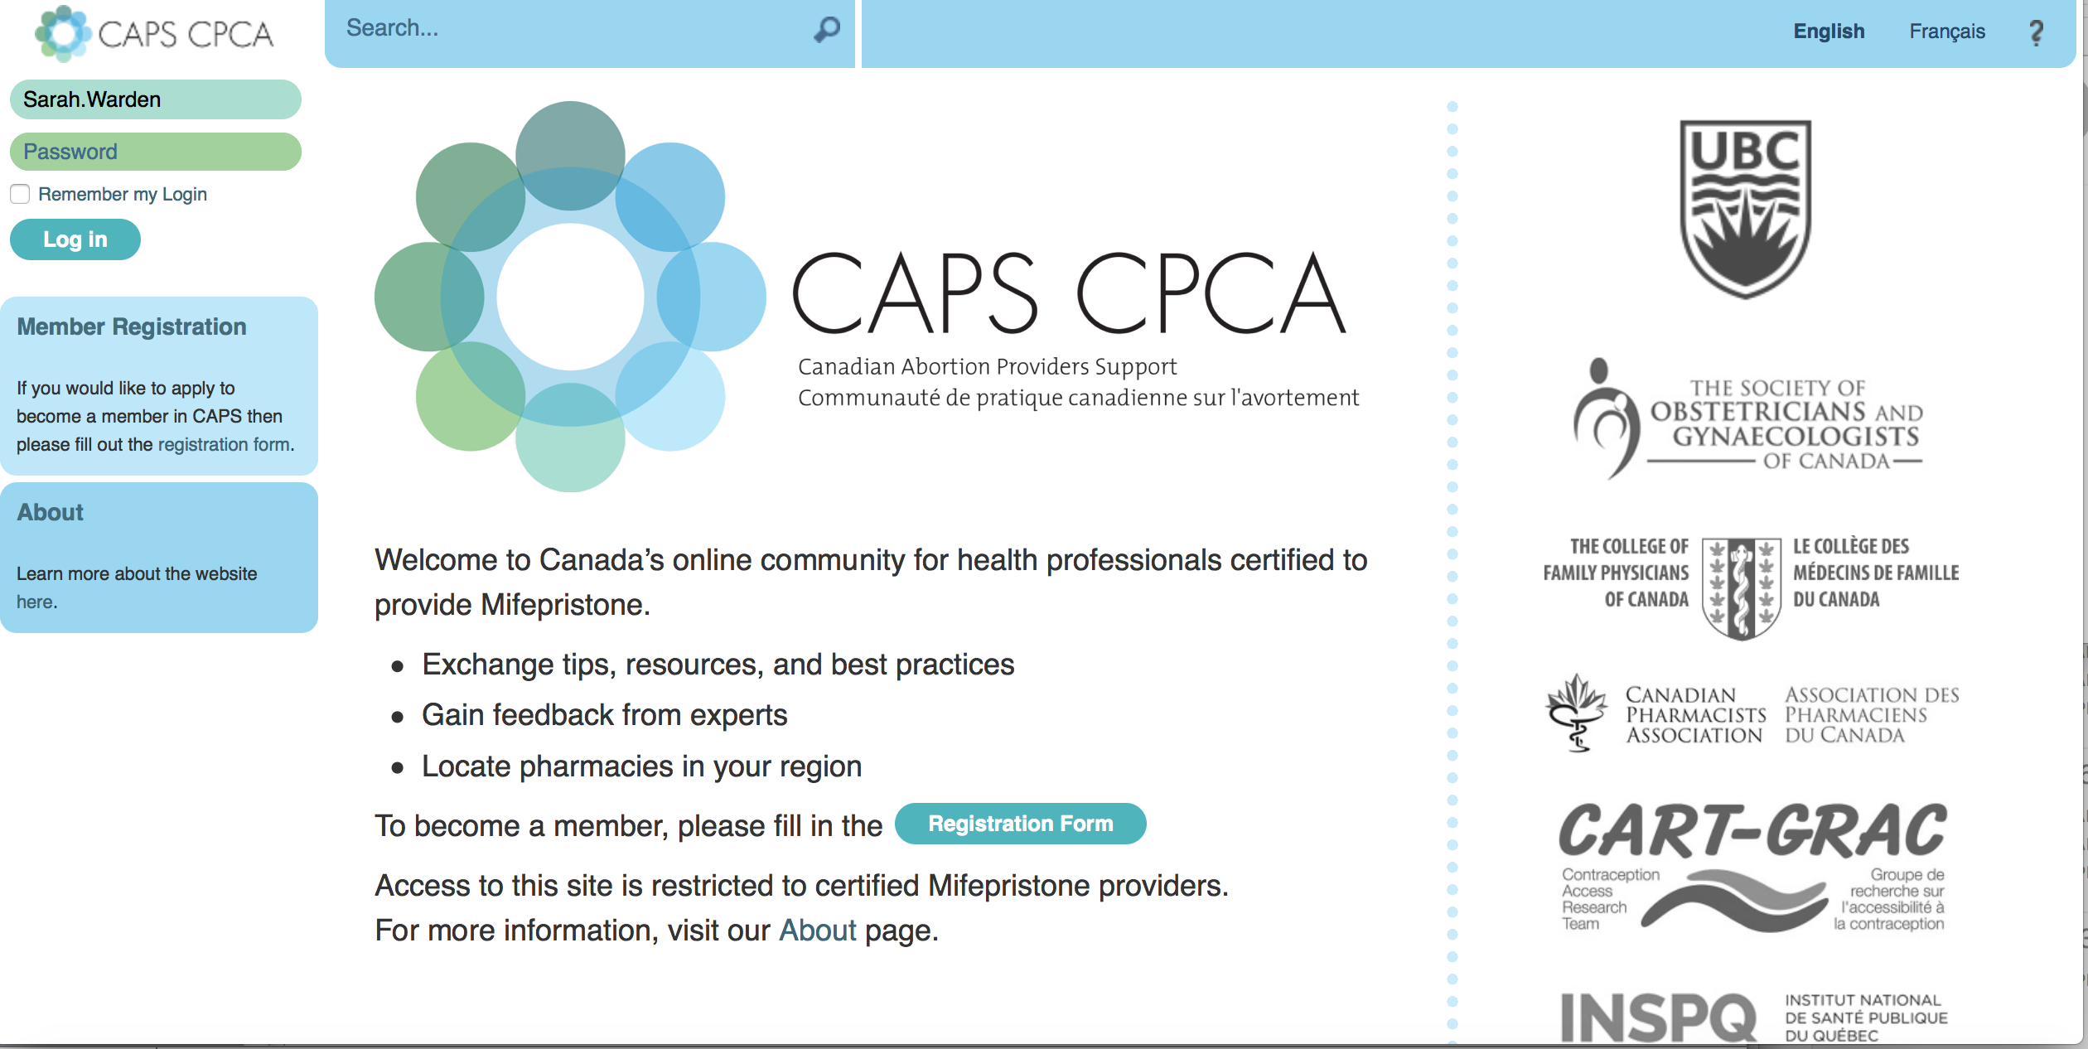
www.caps-cpca.ubc.ca
Notes:
Website put together by the Contraceptive Access Research Team out at UBC spearheaded by Dr. Wendy Norman, leading researcher in contraception and reproductive health

Slide 47
Contacts and Questions:
mel.spence@gmail.com
sarah.warden@wchospital.ca
Websites:
BCBC: http://www.womenscollegehospital.ca/programs-and-services/bcbc/
Medical Abortion: http://www.womenshealthmatters.ca/health-centres/sexual-health/abortion/medical-abortion/

