Slide 1
Addressing Social Health: Health Provider Interventions into the Social Determinants of Health Primary Care Nurses Conference April 14, 2018
Gary Bloch MD CCFP
Family Physician, St. Michael’s Hospital Associate Professor, University of Toronto
Inner City Health Associates

Slide 2
Disclosure
Relevant relationships with commercial entities
None
Potential for conflicts of interest within this presentation
None
Steps taken to review and mitigate potential bias
N/A

Slide 3
Objectives
Examine an evidence-based argument for intervening in poverty in front line care.
Explore practical ways front line health care providers can intervene into a social determinant of health, through the examination of a simple clinical tool on poverty.
Introduce health team-based interventions and advocacy interventions into poverty and other social risks to health.

Slide 7
Real Name and Image Not Used: photo from www.harrycutting.com

Slide 8
Cognitive Status
Functional Status
Detailed Neuro Exam
Multidisciplinary Rehab
Family Meeting

Slide 9
Income
Housing
Immigration
MVA Insurance
Medically Stable

Slide 10
Real Name and Image Not Used: photo from www.harrycutting.com

Slide 11
The Evidence: Poverty and Health
Poverty increases the prevalence and mortality of many diseases
Cardiovascular disease
Diabetes
Cancer
Depression
Chronic Obstructive Pulmonary Disease
Children in low-income families are at higher risk of low birth weight, mental health problems, micronutrient deficiencies, asthma, injuries, and hospitalization

Slide 13
Health Across the Income Spectrum
Is there a health poverty line?
Notes:
Overall health follows a clear income gradient: the lower a person’s income, the worse his or her health.
This 2013 Stats Canada report shows that EACH SUCCESSIVELY lower income quintile is associated with an increase in age-standardized mortality rates for all causes of mortality
So to answer our earlier question, “Is there a Health Poverty Line” – the answer is no. Health is negatively affected at every step down.

Slide 14
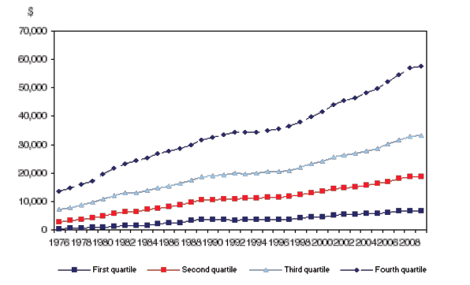
It’s also Inequality

Slide 15
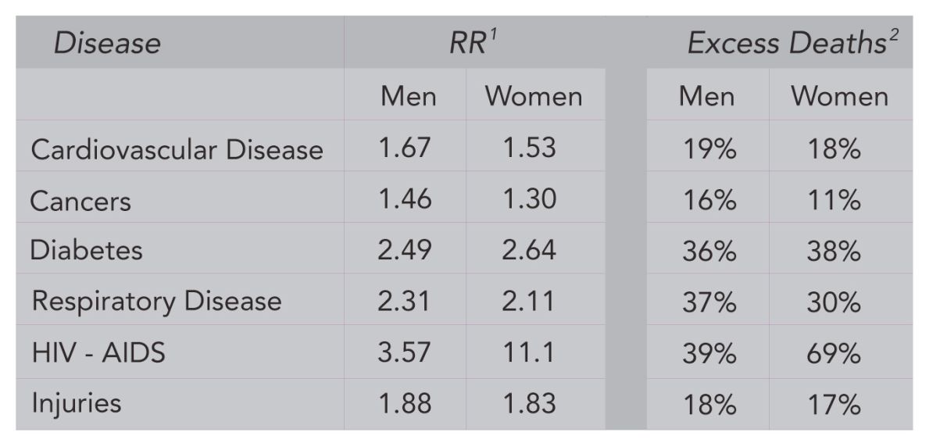
Raphael, Dennis & Bryant, Toba. Income inequality is killing thousands of Canadians every year. November 23, 2014.
http://www.thestar.com/opinion/commentary/2014/11/23/income_inequality_is_killing_thousands_of_canadians_every_year.html ; Table: http://www.thinkupstream.net/health_effects_of_income_inequality
Notes:
Presenter notes: Purpose of slide is to demonstrate mainstream acceptance of the link between income and health.
Highlight 40, 000 premature deaths stat, but in the interest of time do not dwell on individual relative risks/excess deaths (table included for demonstration purposes).

Slide 16
Some Are Disproportionately Affected
Racialized Canadians
Indigenous
People with disabilities
Elderly
Women
Children

Slide 18
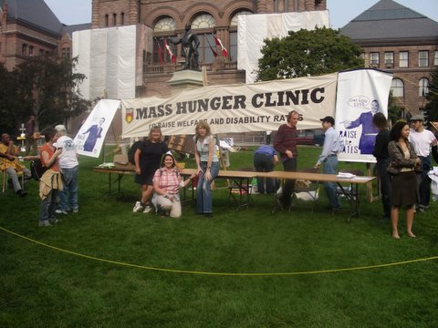

Slide 20
Case Study: Carlos
Carlos (52) was diagnosed with diabetes 6 months ago.
He attended diabetes education sessions, and has been prescribed maximal doses of metformin and glyburide.
Carlos also takes medication for hypertension and high cholesterol.

Slide 21
Case Study: Carlos
Treatment has been minimally successful: his A1c level has dropped from 10.3 to 9.7.

Slide 22
Step 1: Ask, or Screen Everyone
ASK: “Do you ever have difficulty making ends meet at the end of the month?”
Sensitivity: 98% Specificity: 40% (for those living below the poverty line)
Vanessa Brcic et. al., “Development of a Tool to Identify Poverty in a Family Practice Setting: A Pilot Study,” International Journal of Family Medicine. Volume 2011 (2011).
Notes:
The first and arguably most important step is to IDENTIFY those living in Poverty.
While poverty is often hidden, as we have seen, it’s impact is far reaching – so screening everyone is important
Evidence from the field of Palliative Care teaches us that Patients prefer their physicians to be direct when asking about sensitive issues:
Asking something like: “Do You Ever have difficulty making ends meet at the end of the month” has excellent sensitivity in identifying those living in poverty and was found to be acceptable to patients
But this is only one way of asking – there are many ways and we need to find a way that is comfortable for us

Slide 23
Case Study: Carlos
Carlos works as a part-time labourer, earning $14,000 per year.
He lives in a 1 bedroom apartment with his 2 young daughters. Monthly rent: $800.

Slide 24
Step 2: Assess Risk and Educate
If a patient smokes, does this change your screening and diagnostic decision making?
Should poverty similarly affect decision making?
Notes:
The first and arguably most important step is to IDENTIFY those living in Poverty.
While poverty is often hidden, as we have seen, it’s impact is far reaching – so screening everyone is important
Evidence from the field of Palliative Care teaches us that Patients prefer their physicians to be direct when asking about sensitive issues:
Asking something like: “Do You Ever have difficulty making ends meet at the end of the month” has excellent sensitivity in identifying those living in poverty and was found to be acceptable to patients
But this is only one way of asking – there are many ways and we need to find a way that is comfortable for us

Slide 26
Step 3: Intervene and Connect
With Individual Patients
Notes:
The first and arguably most important step is to IDENTIFY those living in Poverty.
While poverty is often hidden, as we have seen, it’s impact is far reaching – so screening everyone is important
Evidence from the field of Palliative Care teaches us that Patients prefer their physicians to be direct when asking about sensitive issues:
Asking something like: “Do You Ever have difficulty making ends meet at the end of the month” has excellent sensitivity in identifying those living in poverty and was found to be acceptable to patients
But this is only one way of asking – there are many ways and we need to find a way that is comfortable for us

Slide 27
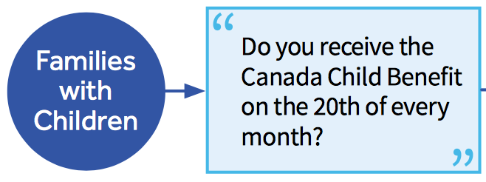
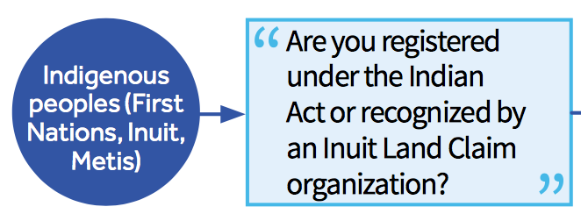

Slide 28
Case Study: Carlos
You recommend Carlos file his taxes.
You refer him to a community agency which helps.

Slide 29
Case Study: Carlos
CRA Child and Family Benefits Calculator (accessed January 2017)

Slide 30
Are Income Interventions Effective?
Healthy Baby Prenatal Benefit (Manitoba)
$81.41 per month for low-income pregnant women with annual income < $21,744
10,738 received the income supplement, 3,853 did not
HBPB reduced preterm births and low birth weight babies
Brownell M, et al. Unconditional Prenatal Income Supplement in Birth Outcomes. Pediatrics 2016
Notes:
There is growing evidence that “no strings attached” income supplements can improve health.
Consider the Healthy Baby Prenatal Benefit in Manitoba, which provides $81 per month for low-income pregnant women. This benefit was found to reduce preterm births and low birth weight babies in a large study involving over 14,0000 women.
---
References:
Brownell M, et al. Unconditional Prenatal Income Supplement in Birth Outcomes. Pediatrics 2016
Thompson H, et al. Evaluating the Health Effects of Social Interventions. BMJ 2004; 328 (7434)L 282-5.

Slide 31
Connect to Resources

Slide 36
Team-based interventions

Slide 38
SDOH Committee
Online Income Tool, ROAR
Decent Work and Health Network
Community Engagement
Income Security Health Promotion
Health Justice Initiative
Health Equity Data Collection
Research&Eval

Slide 39
Socio-demographic data collection
Data for Equity
Language
Immigration
Race/ethnicity
Disabilities
Gender identity
Sexual orientation
Income
Housing

Slide 40
Income Security Health Promoter
Individual Income Interventions
Health Team Capacity
Patient Education
Systemic Advocacy
Front Line Health Positions

Slide 42
Health Justice Project
Individual legal services
Health provider training
Patient Rights education
Systemic advocacy
Intersectoral Partnership

Slide 43
SDOH Committee
Online Income Tool, ROAR
Decent Work and Health Network
Community Engagement
Income Security Health Promotion
Health Justice Initiative
Health Equity Data Collection
Research&Eval

Slide 44
SDOH Committee 2.0
St. Michael’s Hospital Department of Family and Community Medicine
Racism and Health
Advocacy Framework
Supporting the use of Sociodemographic Data
Tools for Equity in Clinical Programs and Services
Equitable Community Engagement Framework

Slide 45
Higher level advocacy

Slide 46
Real Name and Image Not Used: photo from www.shutterstock.com

Slide 49
Why Advocate?
As advocates, health providers are:
Respected.
A surprising voice.
Regularly in contact with vulnerable individuals.
Intimately connected with stories.
Grounded in evidence.

Slide 50
How Health Providers Can Advocate

Slide 51
Add Evidence to Advocacy

Slide 52
Tell Patient Stories

Slide 53
Speak to the Privileged

Slide 54
Join / Work with a Coalition

Slide 55
Conduct/Contribute to Health Equity Research

Slide 56
Engage with Media

Slide 57
Contribute Evidence-Based Opinion Pieces

Slide 58
Meet with Public Policy Makers

Slide 60
Advice to her daughter on entering Medical School:
“Remember what really makes people sick and what makes them well. … you already know that the social determinants of health actually set the stage for all those biomedical actors.
Do your part to influence those social determinants. Speak up when you see the impact of poverty, unemployment, violence, and more”

Slide 61
Objectives
Examine an evidence-based argument for intervening in poverty in front line care.
Explore practical ways front line health care providers can intervene into a social determinant of health, through the examination of a simple clinical tool on poverty.
Introduce health team-based interventions and advocacy interventions into poverty and other social risks to health.

Slide 62
Gary Bloch MD CCFP
Family Physician, St. Michael’s Hospital &
Inner City Health Associates
Associate Professor, University of Toronto
Health Providers Against Poverty
gary.bloch@utoronto.ca
@Gary_Bloch

